Slide 1
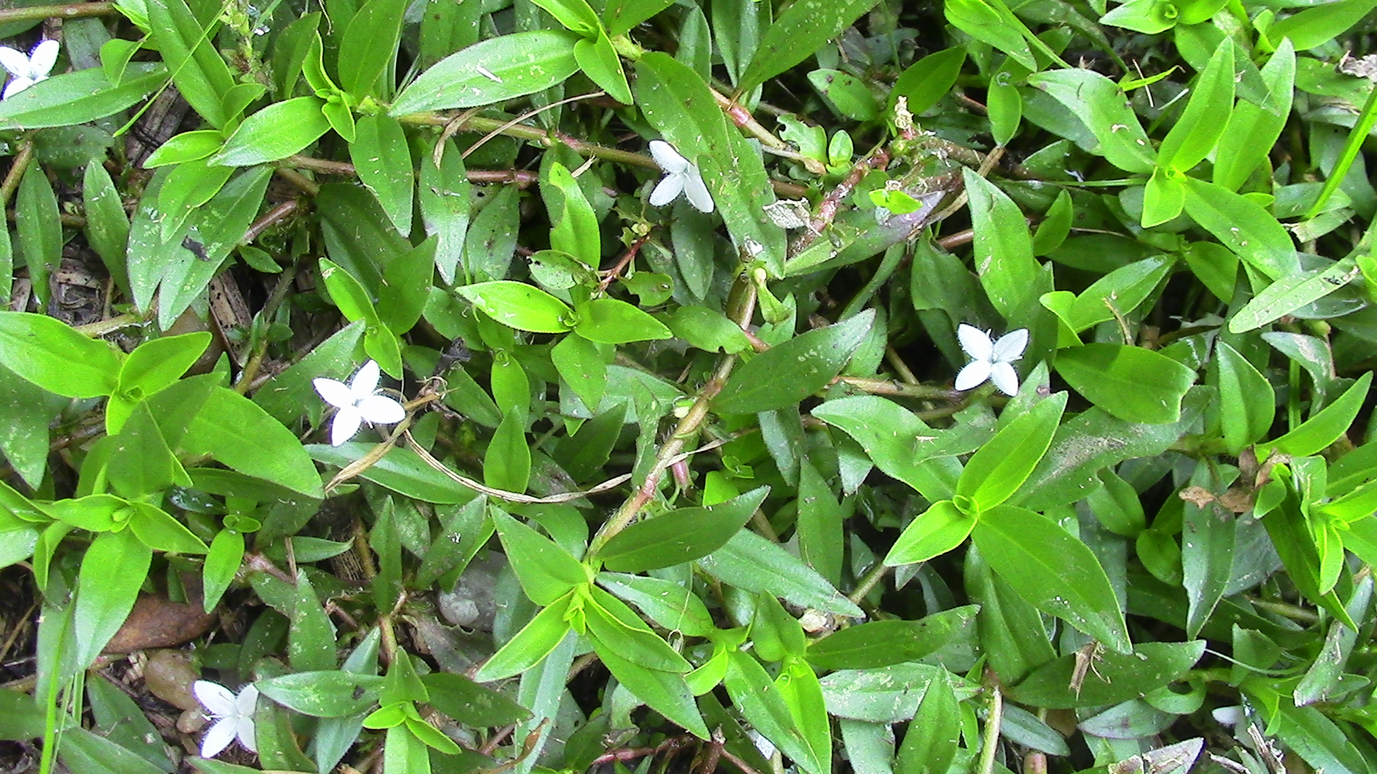
Chickweed Photo by: DNR Staff

Slide 2
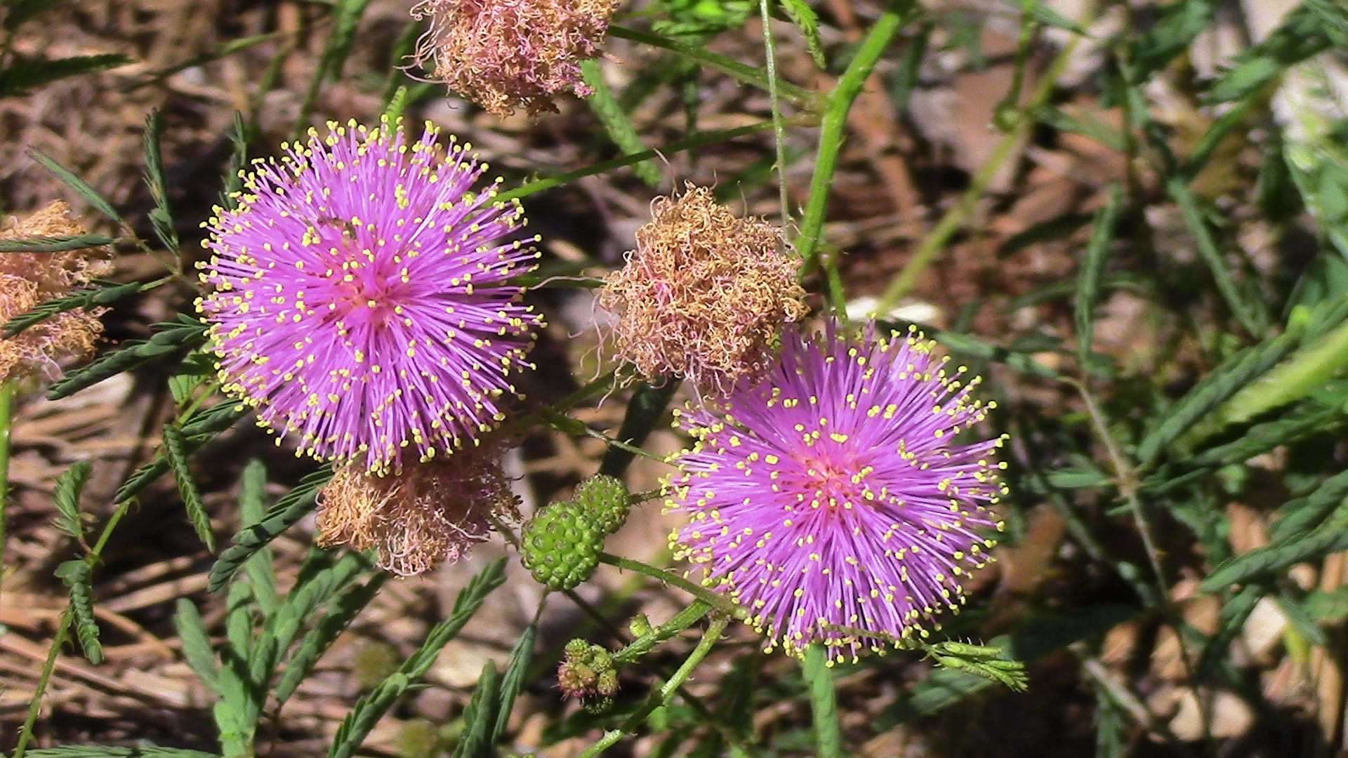
Little Leaf Sensitive Briar
Photo by: DNR Staff

Slide 3
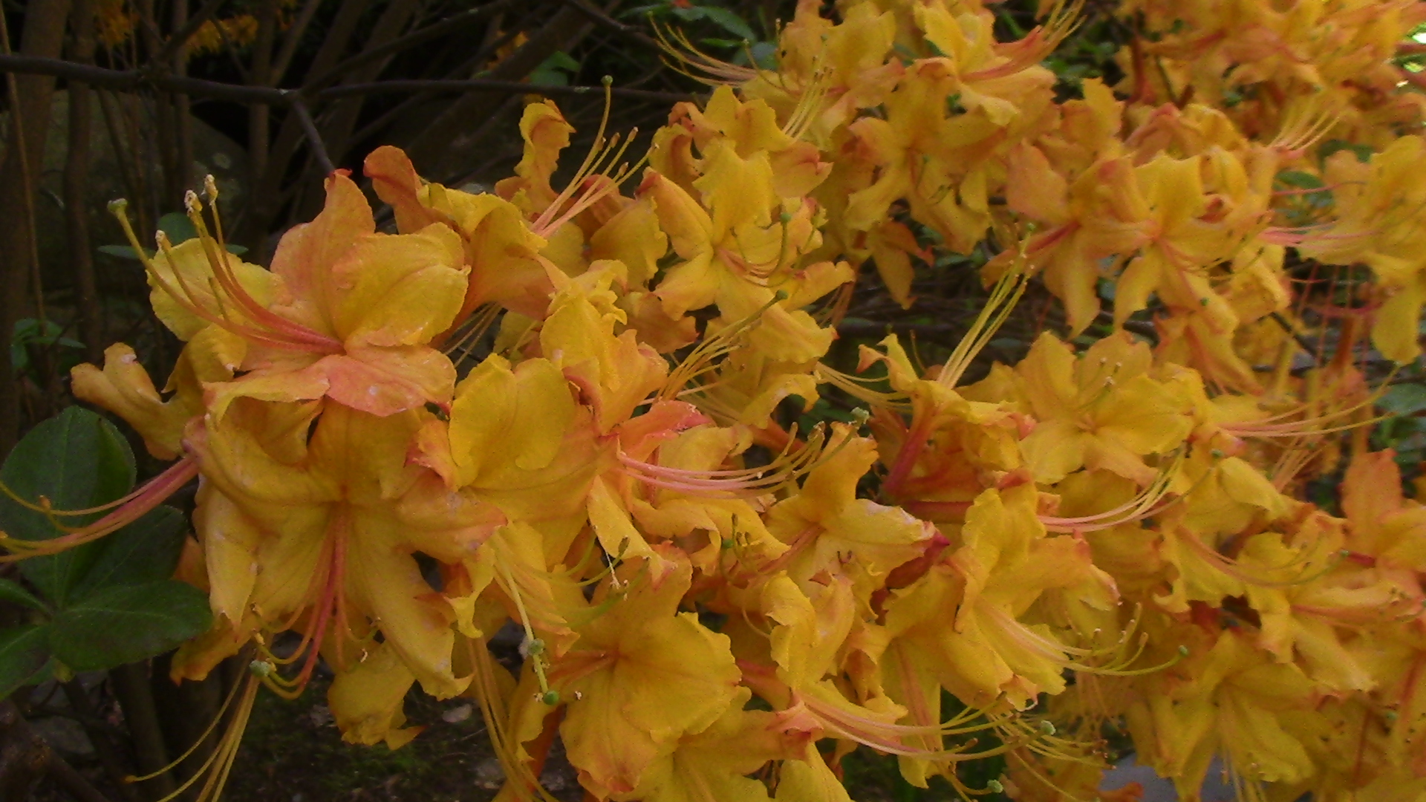
Flame Azalea
Photo by: DNR Staff

Slide 4
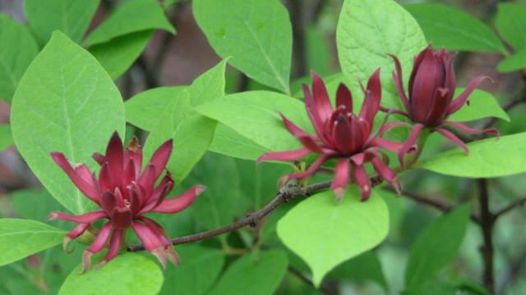
Sweetshrub
Photo by: DNR Staff

Slide 5
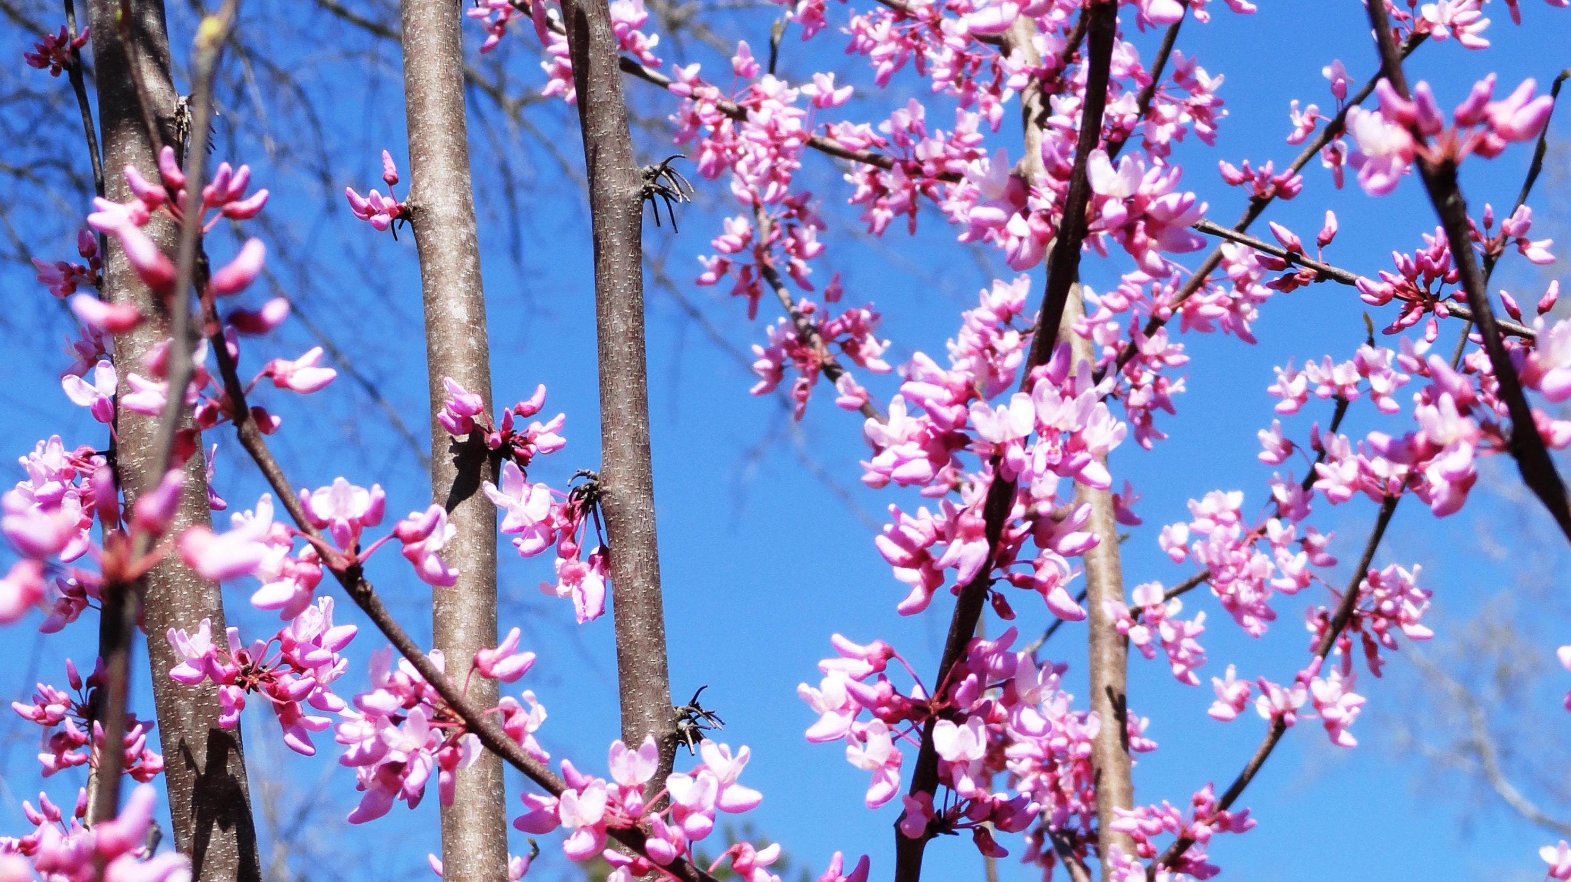
Redbud
Photo by: DNR Staff

Slide 6
Trout lily
Photo by: DNR Staff

Slide 7
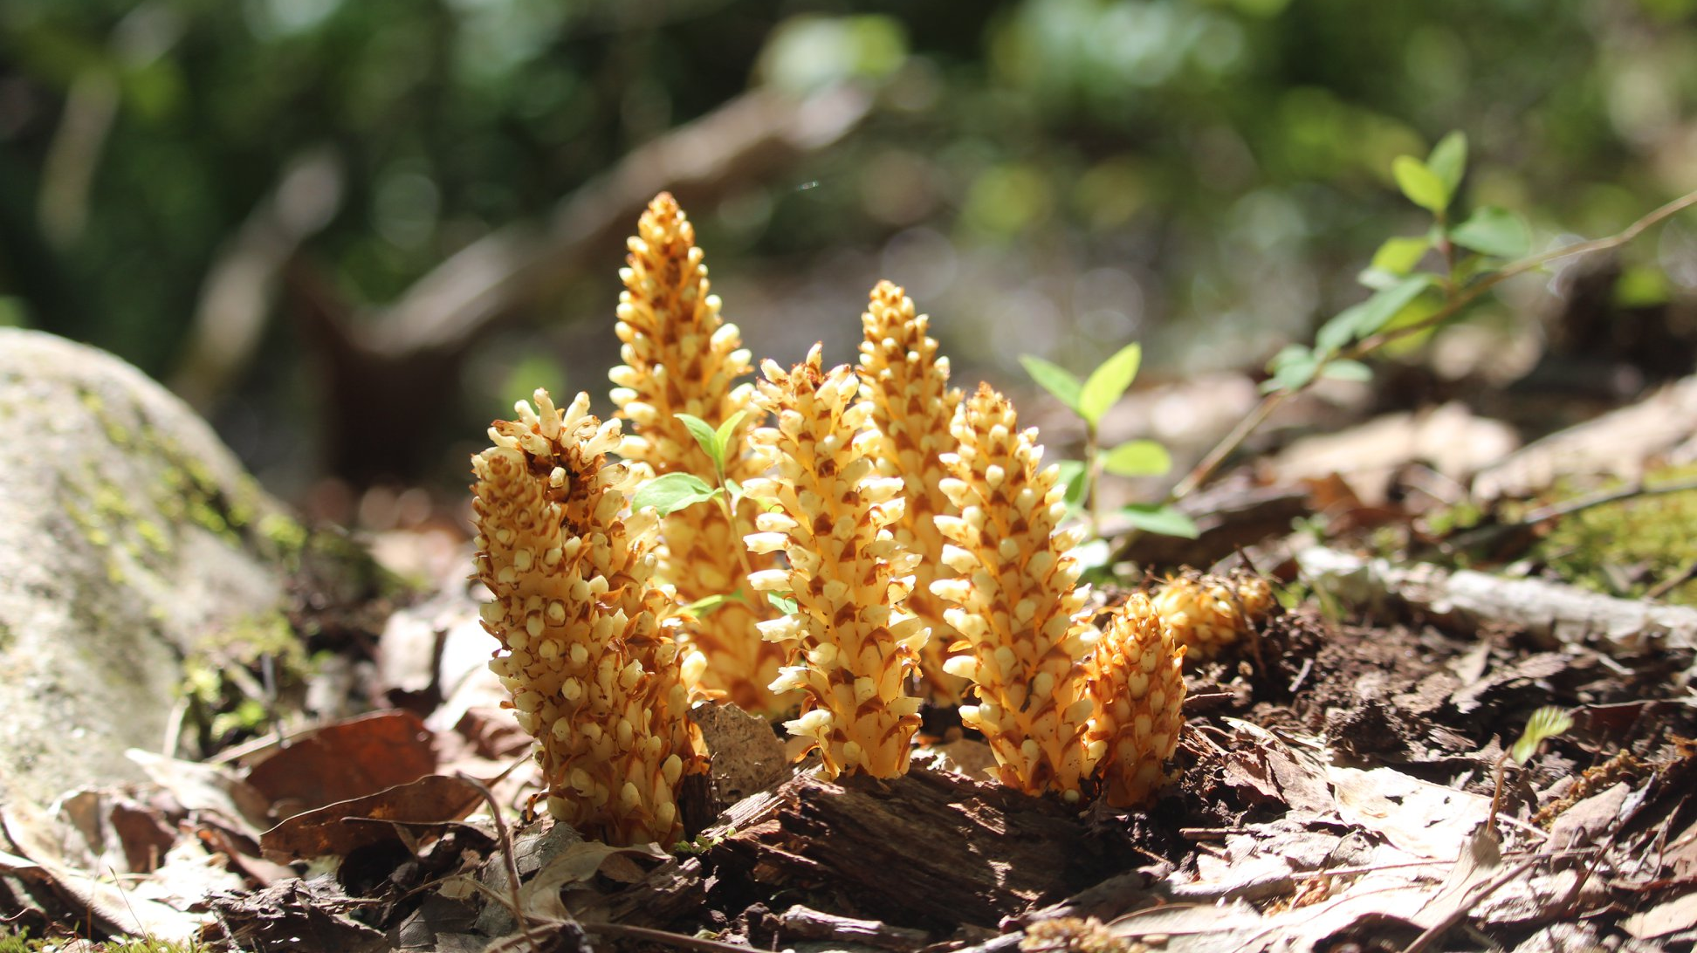
Squawroot
Photo by: DNR Staff

Slide 8
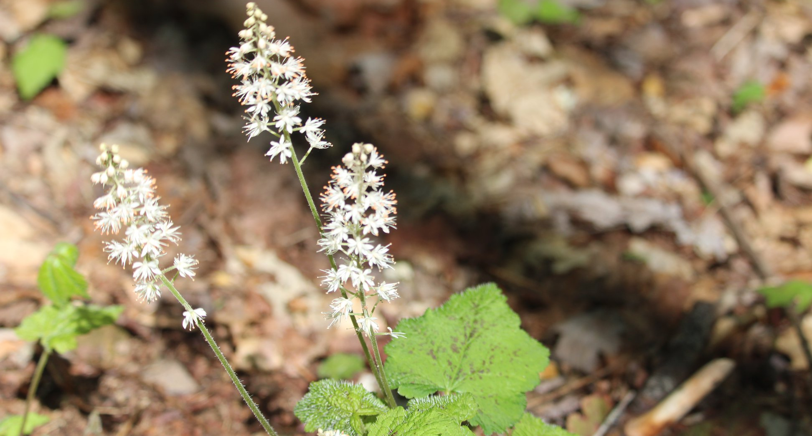
Heartleaf Foamflower
Photo by: DNR Staff

Slide 9
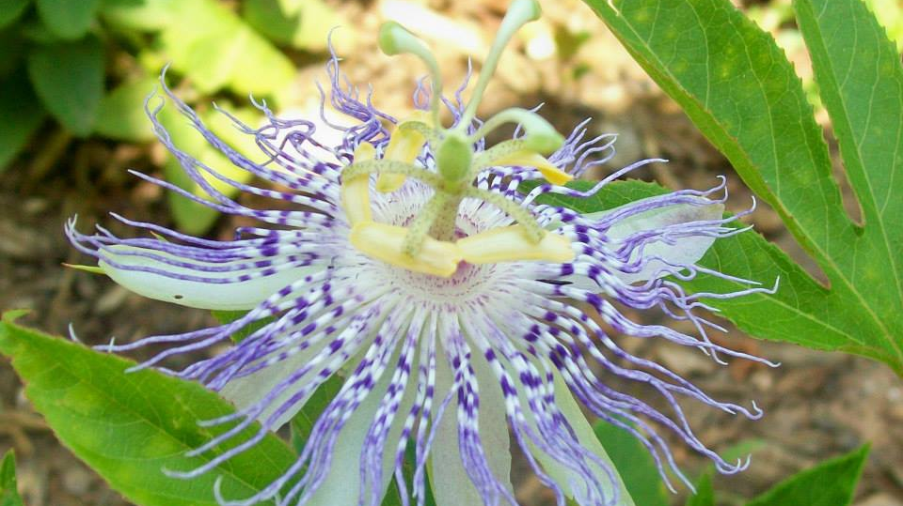
Passionflower
Photo by: DNR Staff

Slide 10
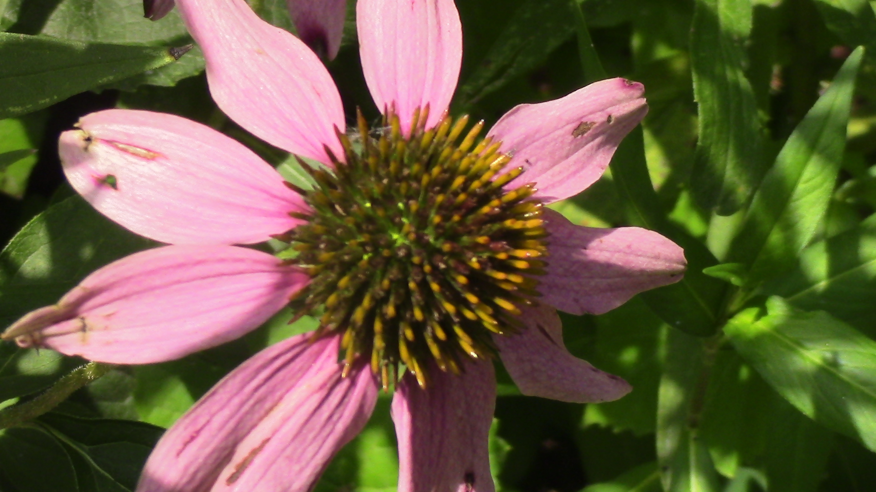
Purple Coneflower
Photo by: DNR Staff

Slide 11
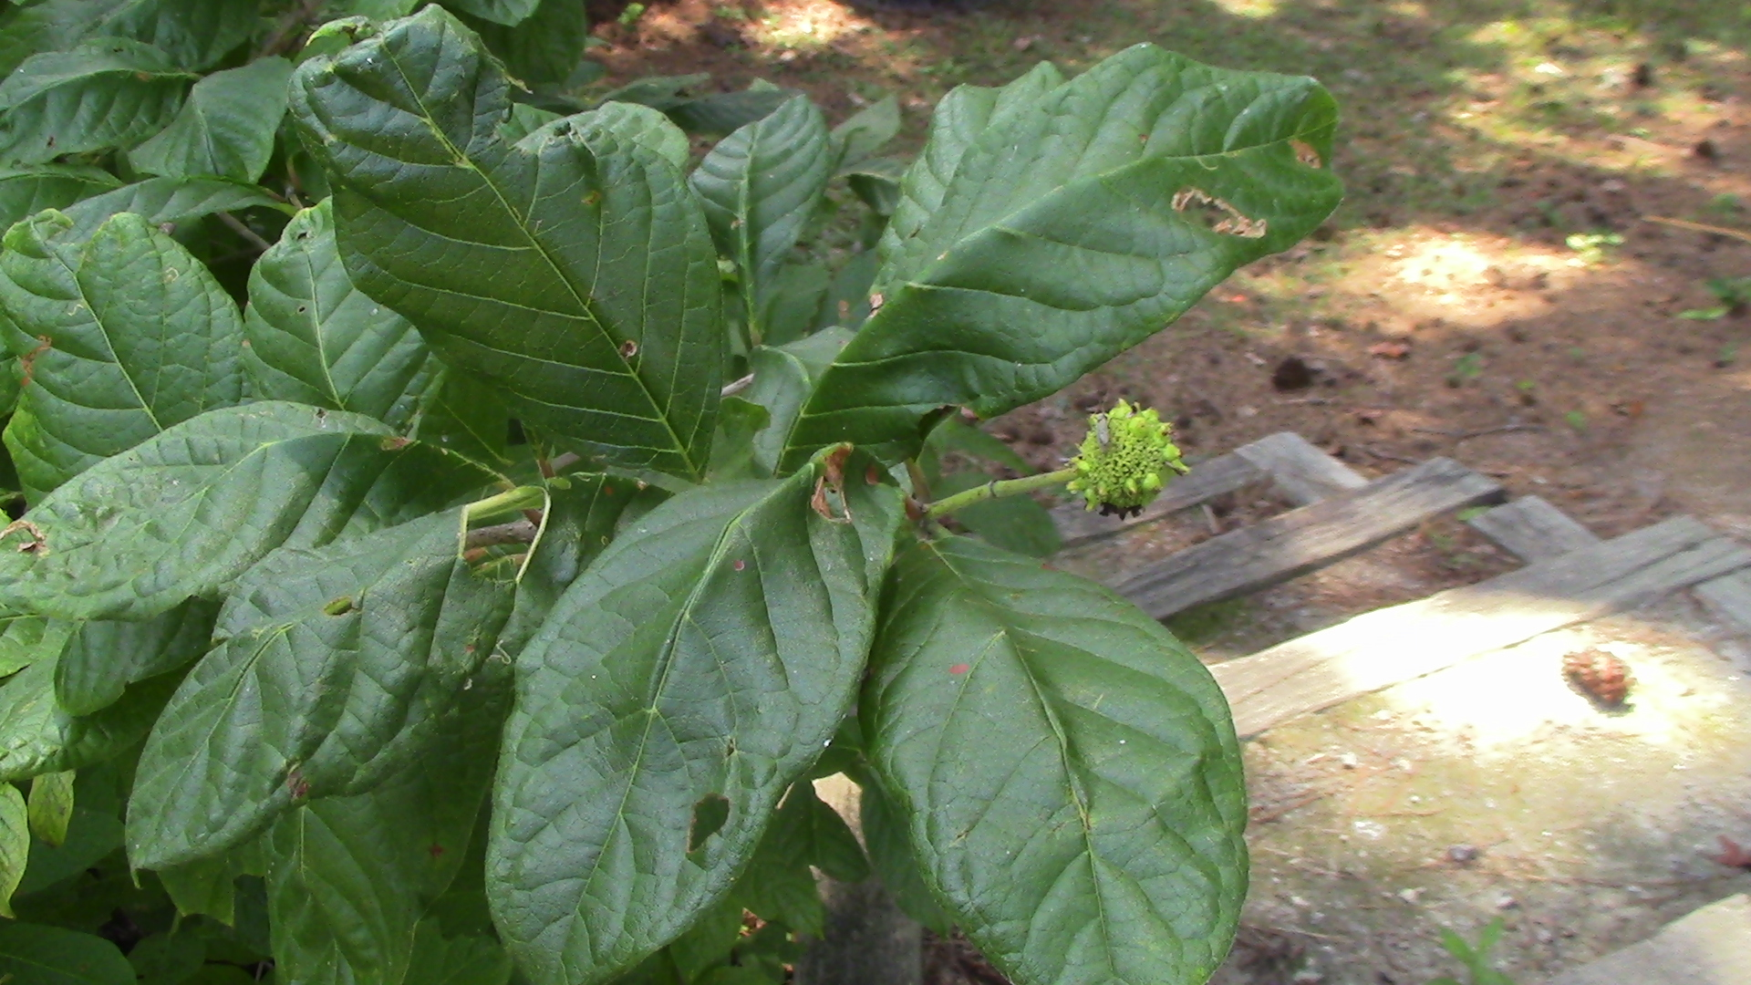
Buttonbush
Photo by: DNR Staff

Slide 12
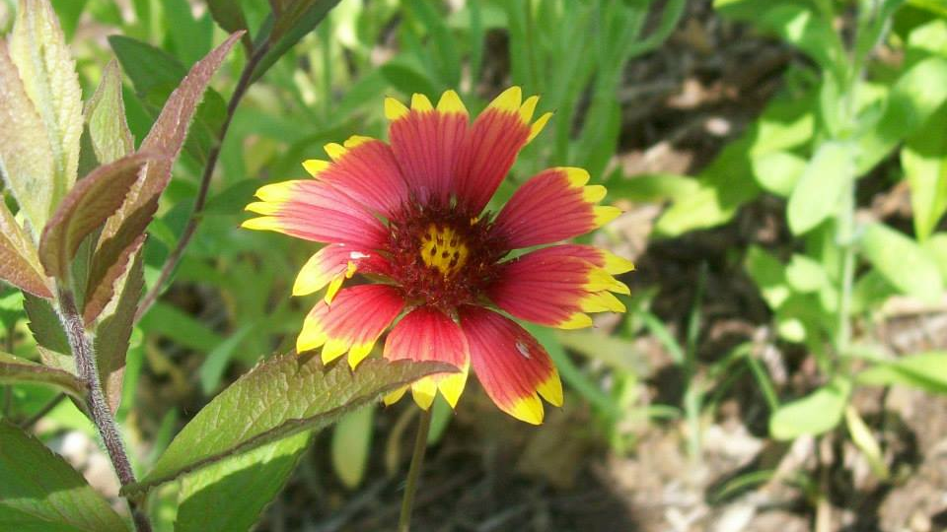
Indian Blanketflower
Photo by: DNR Staff

Slide 13
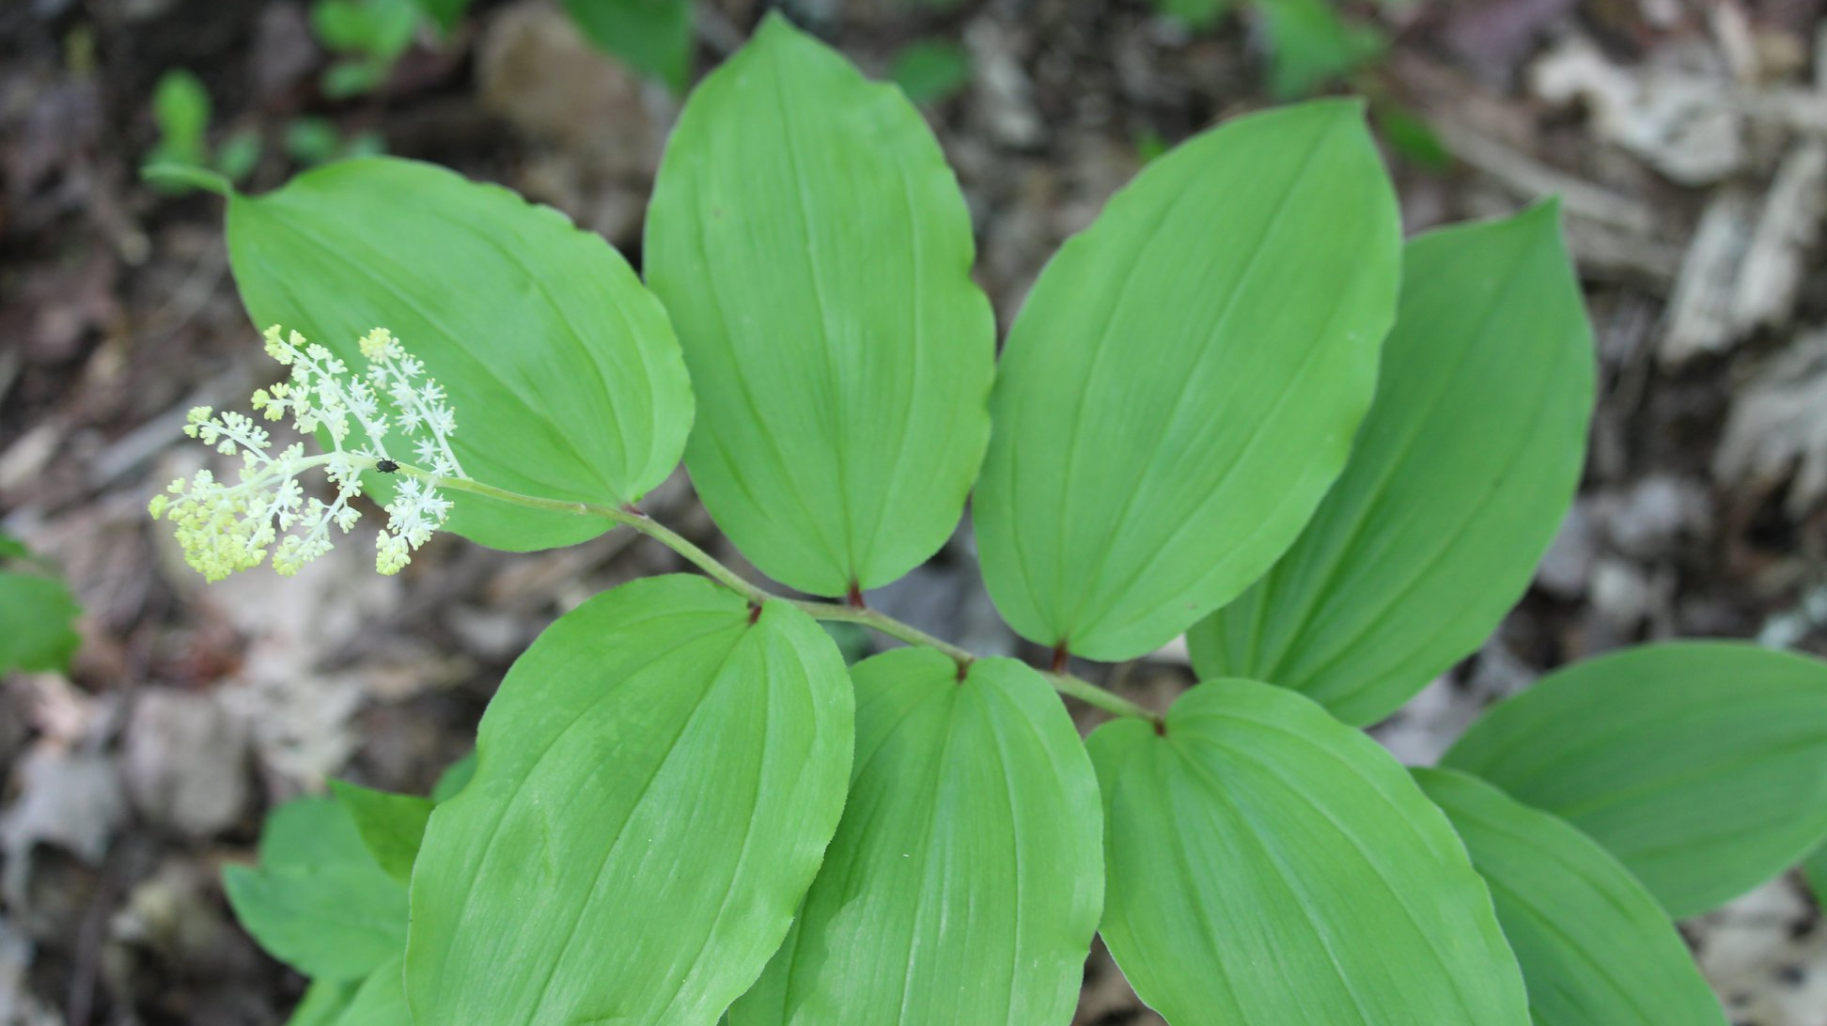
False Solomon’s Seal
Photo by: DNR Staff

Slide 14
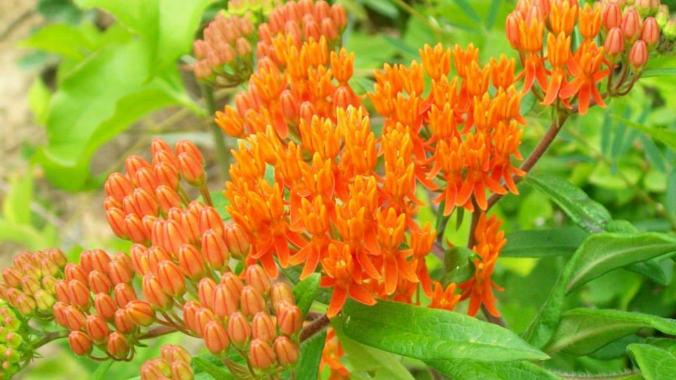
Butterfly Weed
Photo by: DNR Staff

Slide 15
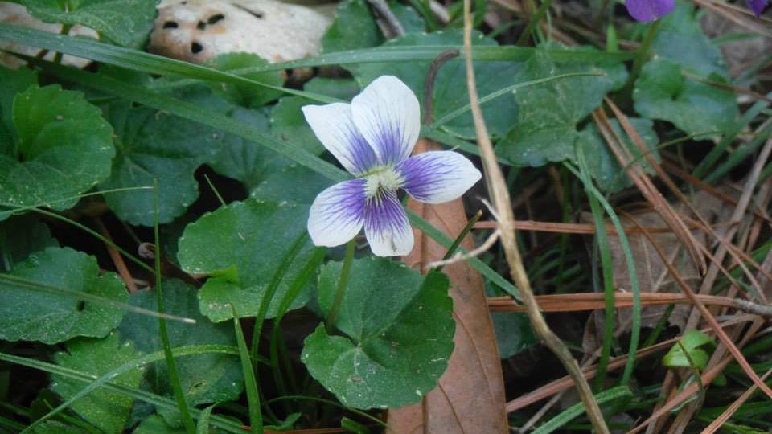
Common Violets
Photo by: DNR Staff

Slide 16
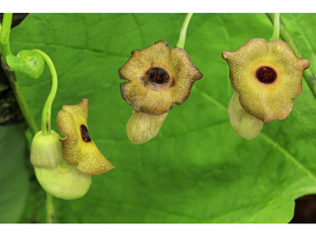
Pipevine
Photo by: DNR Staff

Slide 17
Cardinal Flower
Photo by: DNR Staff

Slide 18
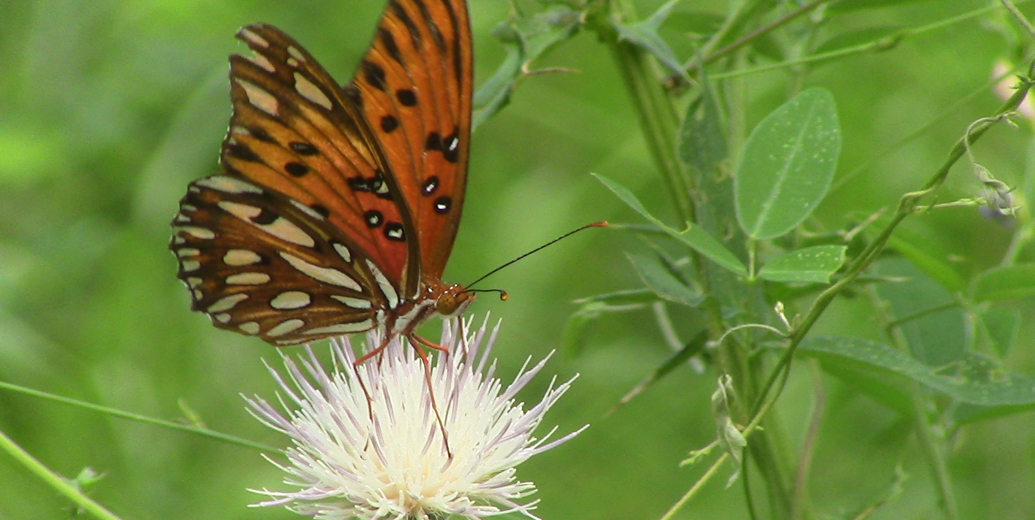
Butterflies

Slide 19
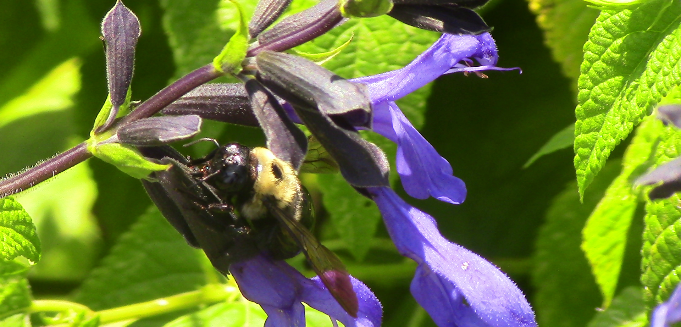
Carpenter Bees

Slide 20
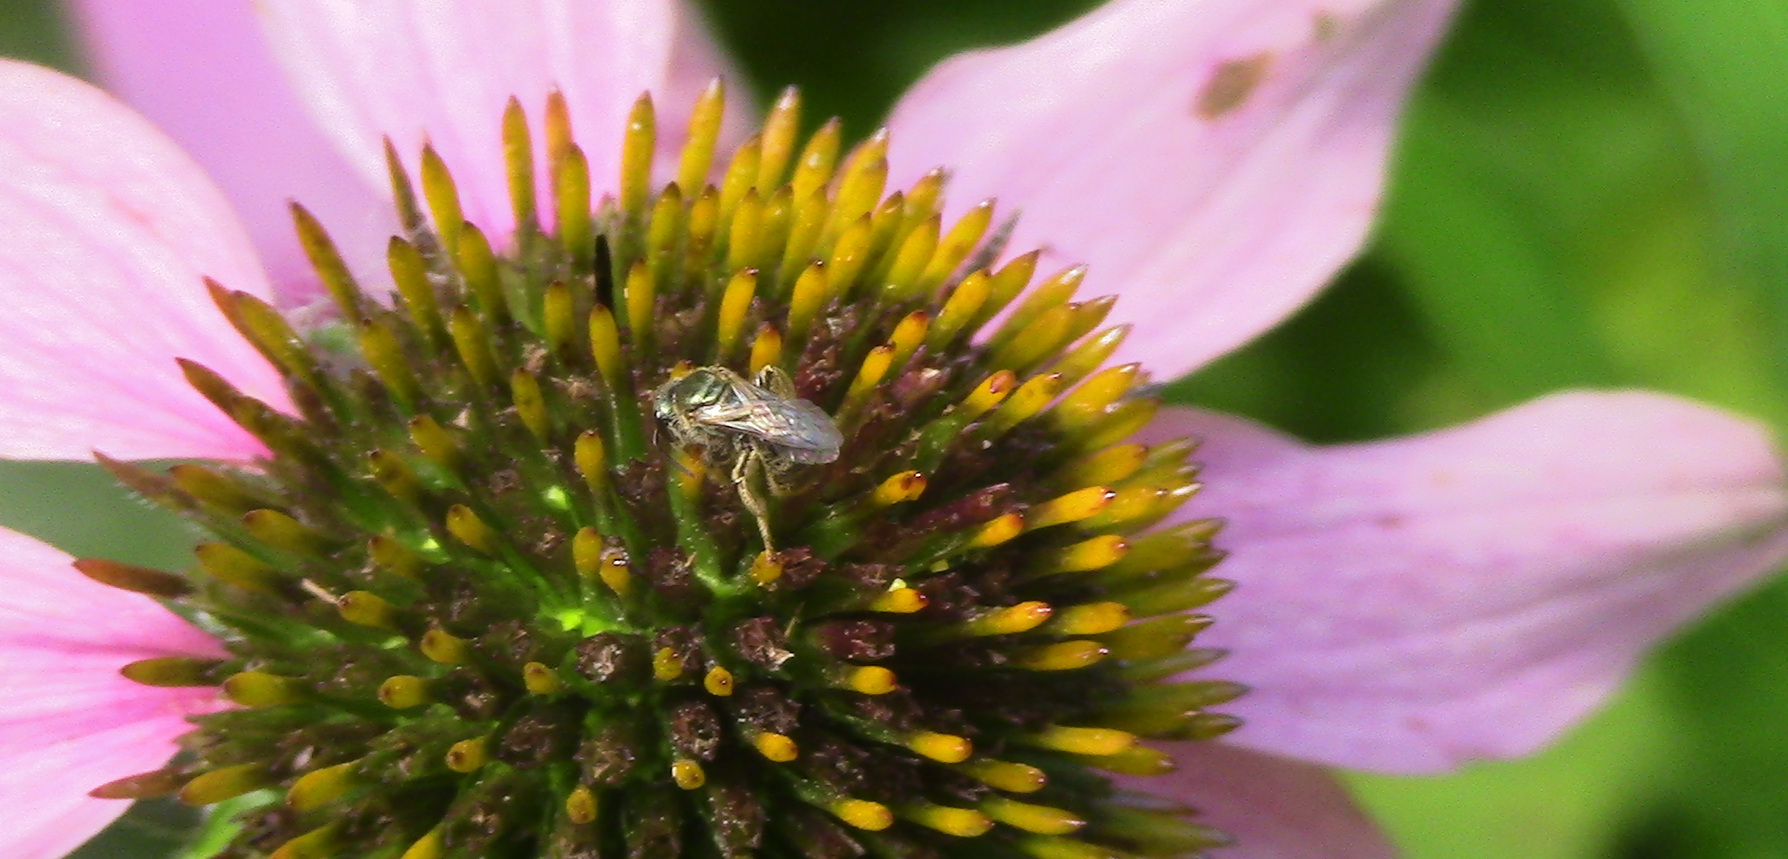
Sweat Bees

Slide 21
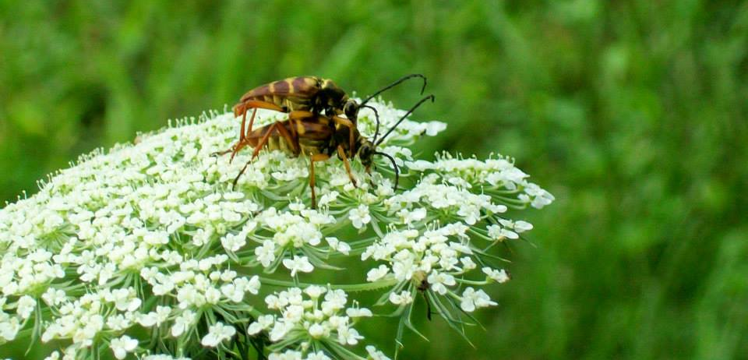
Beetles

Slide 22
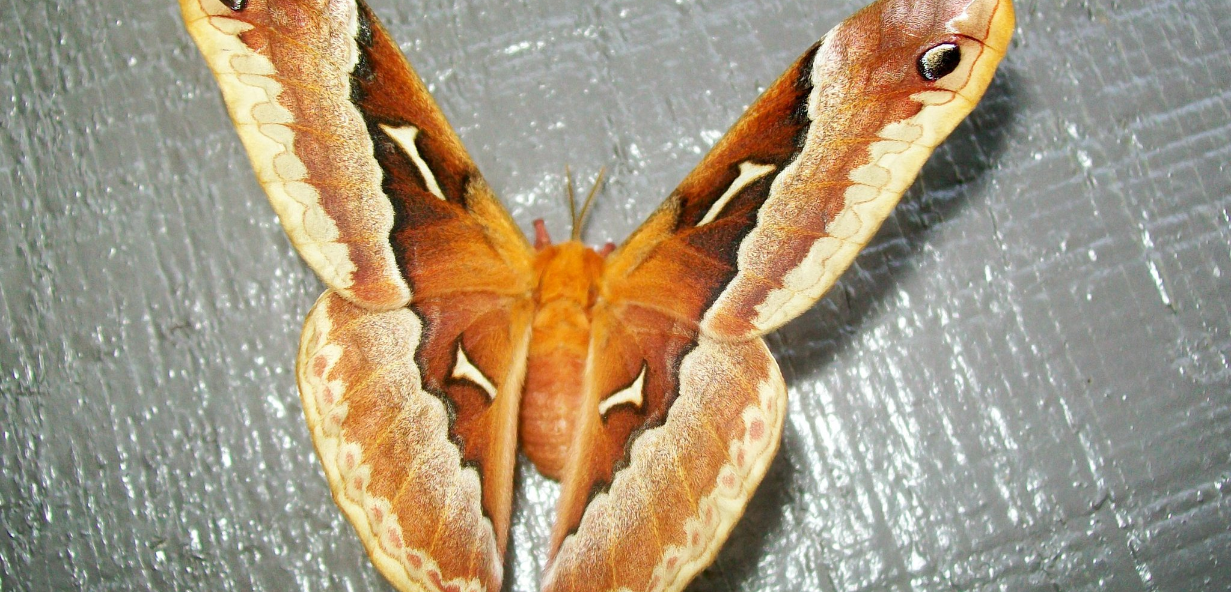
Moths

Slide 23
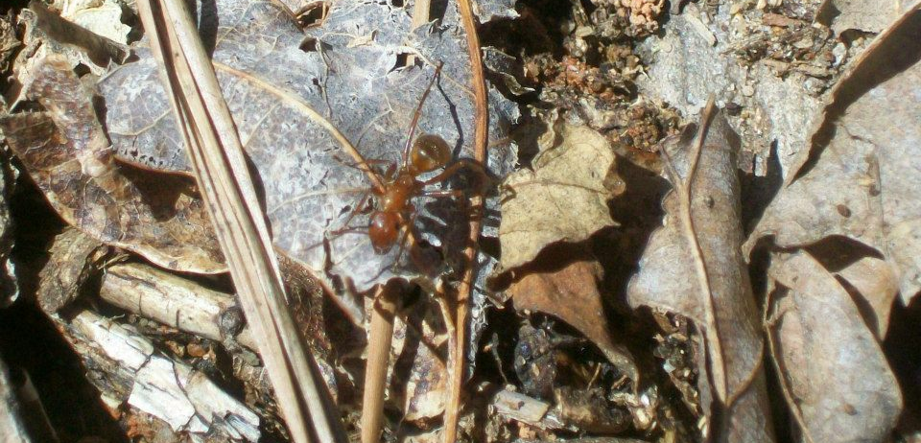
Ants

Slide 24
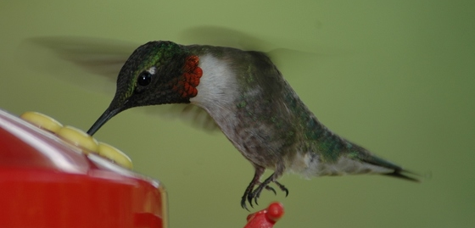
Hummingbirds
Photo credit: Todd Schneider-GA DNR

